Slide 1
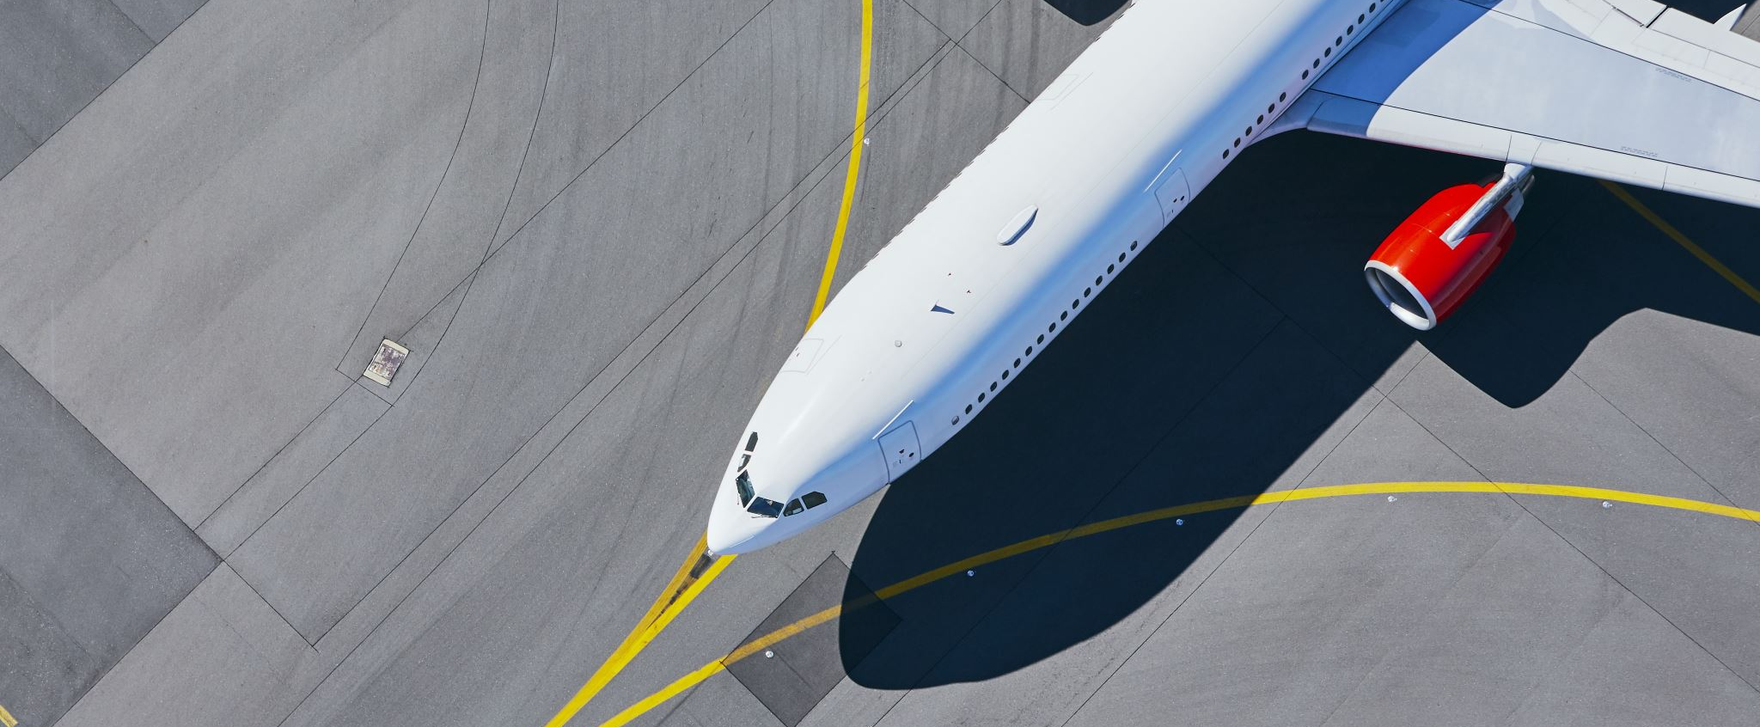
British Airways Customer Booking Insight.

Slide 2
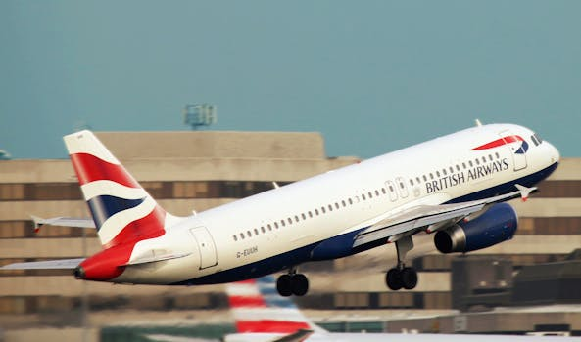
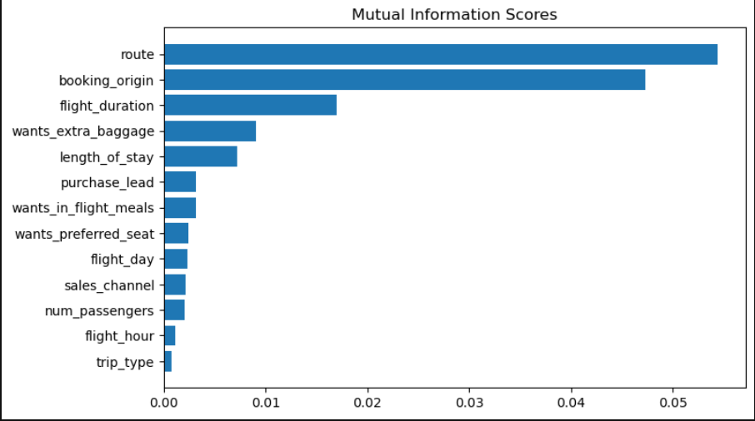
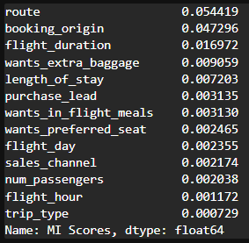
Model To Determine The Factors That Influences Buying The Ticket.
Trained a Model to Predict the Buying convert using Ensemble of Random Forest and XG Boosting.
Accuracy achieved : 85.22%
AUC : 0.5463255454417241
Route.
Booking Origin.
Flight Duration.
Extra Baggage.
Length of the Stay.
Above is the top 5 most important factors influencing the purchase.

